Slide 1


MATH 242
Analytic Geometry and Calculus B
Section 12
Instructor: Jacob Wyngaard
U-Substitution

Slide 2
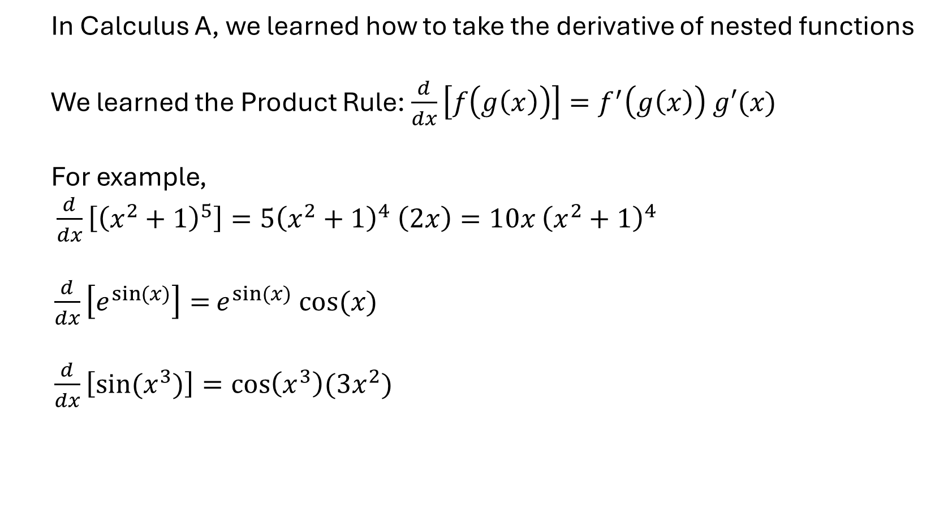
Background
  In Calculus A, we learned how to take the derivative of nested functions
  We learned the Product Rule: $\frac{d}{dx}\left[f\left(g\left(x\right)\right)\right]=f^{′}\left(g\left(x\right)\right) g′(x)$
  For example,
  $\frac{d}{dx}\left[{\left(x^{2}+1\right)}^{5}\right]=5{\left(x^{2}+1\right)}^{4} \left(2x\right)=10x$ ${\left(x^{2}+1\right)}^{4}$
$\frac{d}{dx}\left[e^{sin⁡(x)}\right]=$ $e^{sin⁡(x)} cos⁡(x)$
$\frac{d}{dx}\left[sin⁡(x^{3})\right]=cos\left(x^{3}\right)(3x^{2})$

Slide 3
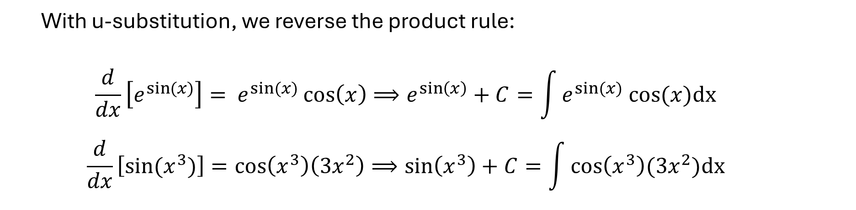

U-Substitution
  With u-substitution, we reverse the product rule:
  $$\frac{d}{dx}\left[e^{sin⁡(x)}\right]= e^{sin⁡(x)}\cos\left(x\right)⟹e^{\sin\left(x\right)}+C=\int{e^{sin⁡(x)} cos⁡(x)\text{dx} }$$
  $$\frac{d}{dx}\left[sin⁡(x^{3})\right]=cos\left(x^{3}\right)\left(3x^{2}\right)⟹\sin\left(x^{3}\right)+C=\int{cos\left(x^{3}\right)(3x^{2})\text{dx} }$$
  For u-substitution, we have to identify the outer function and the inner function
$$\int{cos\left(x^{3}\right)(3x^{2})\text{dx} }$$
outer function
inner function

Slide 4


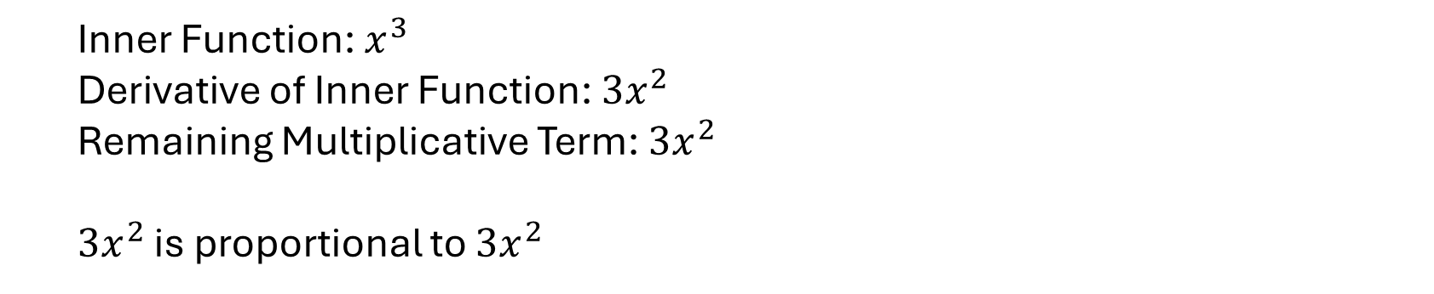
U-Substitution
  We also want to identify any terms that are multiplied with our outer function
$$\int{cos\left(x^{3}\right)(3x^{2})\text{dx} }$$
outer function
remaining multiplicative term
inner function
  For u-substitution to work, the derivative of the inner function must be proportional to the remaining multiplicative term
  Inner Function: $x^{3}$
  Derivative of Inner Function: ${3x}^{2}$
  Remaining Multiplicative Term: $3x^{2}$
  ${3x}^{2}$ is proportional to ${3x}^{2}$

Slide 5

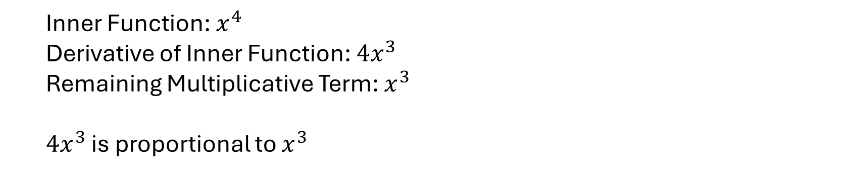
An Example
  Does u-substitution work for the following integral?
$$\int{cos\left(x^{4}\right)(x^{3})\text{dx} }$$
  **For u-substitution to work, the derivative of the inner function must be proportional to the remaining multiplicative term**
  Inner Function: $x^{4}$
  Derivative of Inner Function: ${4x}^{3}$
  Remaining Multiplicative Term: $x^{3}$
  ${4x}^{3}$ is proportional to $x^{3}$

Slide 6


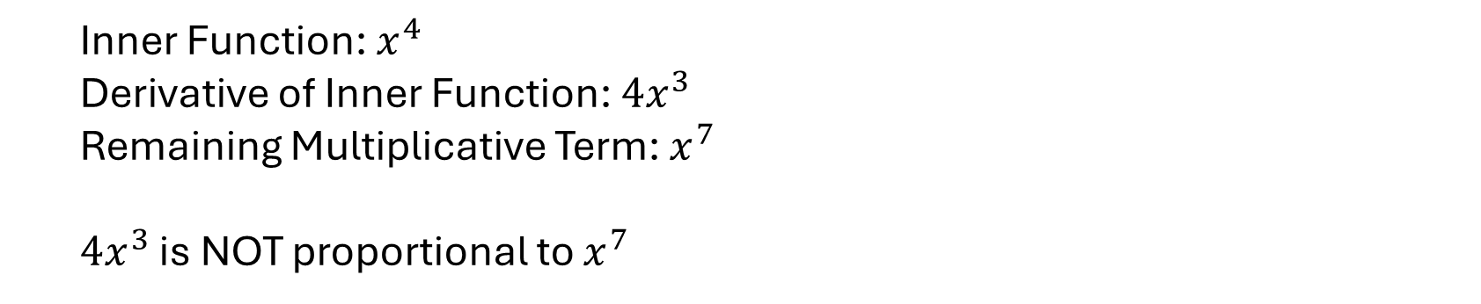
An Example
  Does u-substitution work for the following integral?
$$\int{cos\left(x^{4}\right)(x^{7})\text{dx} }$$
  **For u-substitution to work, the derivative of the inner function must be proportional to the remaining multiplicative term**
  Inner Function: $x^{4}$
  Derivative of Inner Function: ${4x}^{3}$
  Remaining Multiplicative Term: $x^{7}$
  ${4x}^{3}$ is NOT proportional to $x^{7}$

Slide 7

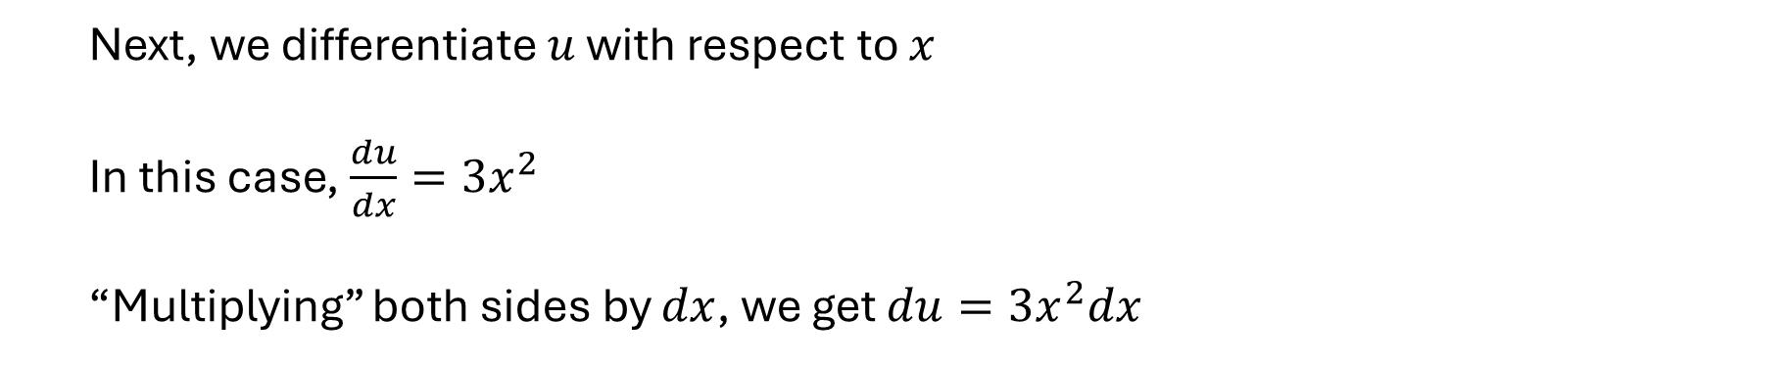
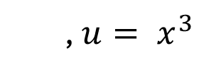
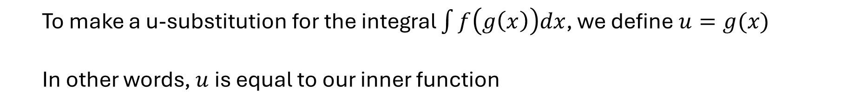
U-Substitution Method
  To make a u-substitution for the integral $\int{f\left(g\left(x\right)\right)dx}$, we define $u=g(x)$
  In other words, $u$ is equal to our inner function
$$\int{cos\left(x^{3}\right)(3x^{2})\text{dx} }$$
  So for
  , $u= x^{3}$
  Next, we differentiate $u$ with respect to $x$
  In this case, $\frac{du}{dx}=3x^{2}$
  “Multiplying” both sides by $dx$, we get $du=3x^{2}dx$

Slide 8

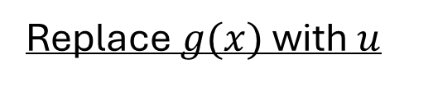
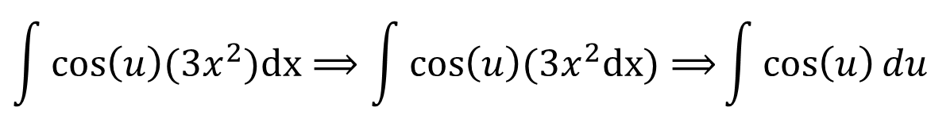
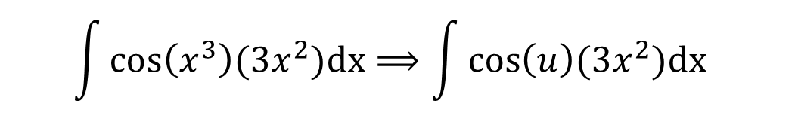
U-Substitution Method
  Next, we transform our integral by replacing $g(x)$ with $u$, and replacing our $dx$ term with its equivalent $du$ expression
Replace $g(x)$ with $u$
$$\int{cos\left(x^{3}\right)(3x^{2})\text{dx}⟹\int{cos\left(u\right)(3x^{2})\text{dx} }}$$
Replace $dx$ with equivalent $du$ expression
$$\int{cos\left(u\right)(3x^{2})\text{dx}⟹\int{cos\left(u\right)(3x^{2}\text{dx}\text{)}⟹}}\int{\cos\left(u\right)du}$$

Slide 9
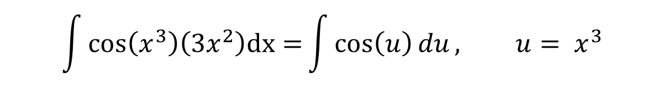
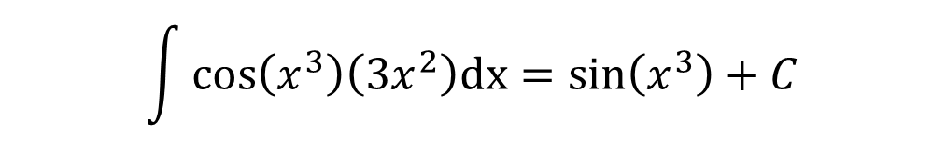
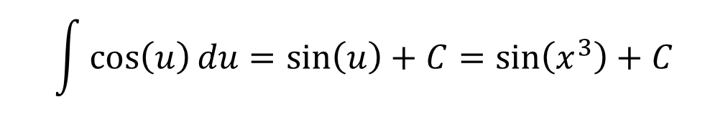
U-Substitution Method
$$\int{cos\left(x^{3}\right)\left(3x^{2}\right)\text{dx}=}\int{\cos\left(u\right)du}, u= x^{3}$$
  Thus,
  All we have to do now is evaluate the integral with respect for u and plug in $u= x^{3}$
$$\int{\cos\left(u\right)du}=\sin\left(u\right)+C=\sin\left(x^{3}\right)+C$$
$$\int{cos\left(x^{3}\right)\left(3x^{2}\right)\text{dx}}=\sin\left(x^{3}\right)+C$$
Therefore,

Slide 10
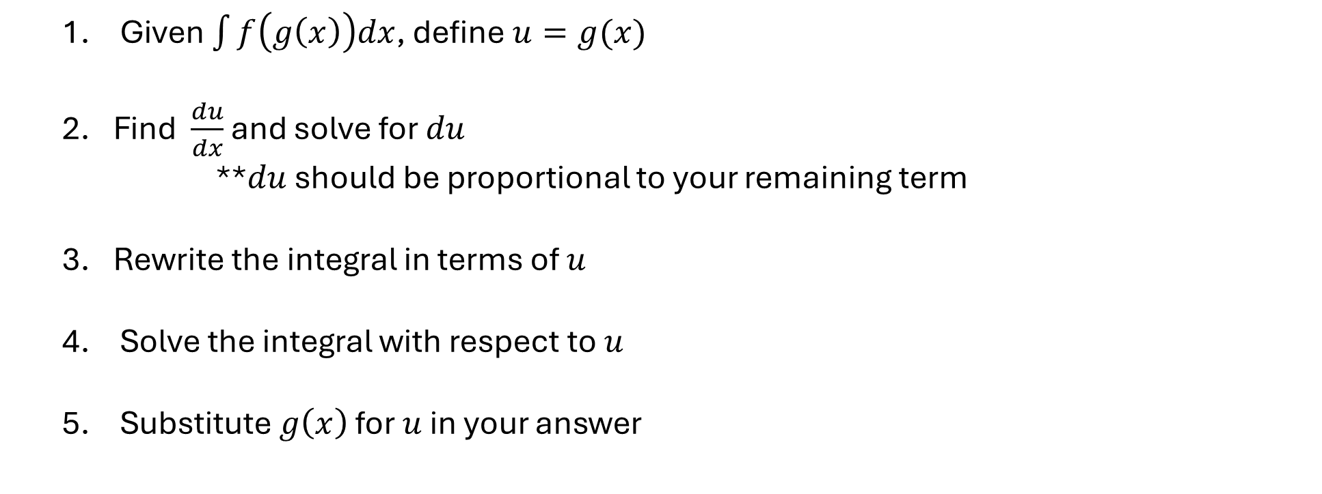
U-Substitution Method To-Do List
  Given $\int{f\left(g\left(x\right)\right)dx}$, define $u=g(x)$
  Find $\frac{du}{dx}$ and solve for $du$
    **$du$ should be proportional to your remaining term
  Rewrite the integral in terms of $u$
  Solve the integral with respect to $u$
  Substitute $g\left(x\right)$ for $u$ in your answer

Slide 11




By-the-Numbers Example
$$\int{{x e}^{2x^{2}+5}\text{dx} }$$
  Solve
  Given $\int{f\left(g\left(x\right)\right)dx}$, define $u=g(x)$
$$\int{{x e}^{2x^{2}+5}\text{dx} }$$
outer function
inner function
remaining multiplicative term
  Outer Function $f(x)$: $e^{x}$
  Inner Function $g(x)$: ${2x}^{2}+5$
  Remaining Multiplicative Term: $x$
  $$u={2x}^{2}+5$$

Slide 12
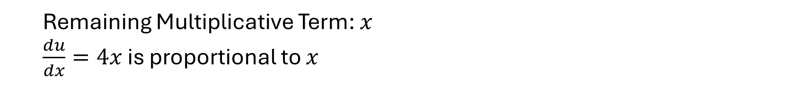
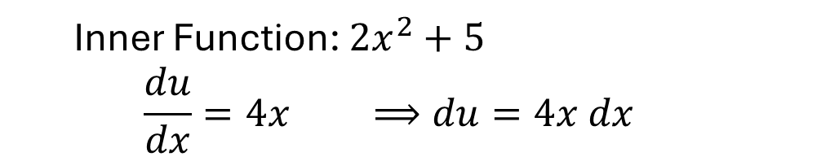
By-the-Numbers Example
$$\int{{x e}^{2x^{2}+5}\text{dx} }$$
  Solve
  2. Find $\frac{du}{dx}$ and solve for $du$
  Inner Function: ${2x}^{2}+5$
  $$\frac{du}{dx}=4x ⟹du=4x dx$$
Check:
  Remaining Multiplicative Term: $x$
  $\frac{du}{dx}=4x$is proportional to $x$

Slide 13
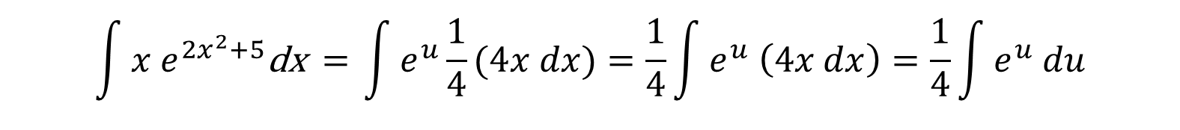



By-the-Numbers Example
$$\int{{x e}^{2x^{2}+5}\text{dx} }$$
  Solve
  3. Rewrite the integral in terms of $u$
  $${u=2x}^{2}+5$$
$du=4x dx$
$$\int{{x e}^{2x^{2}+5}\text{dx} \text{= }\int{e^{u}\frac{1}{4}(4x dx)}}=\frac{1}{4}\int{e^{u} \left(4x dx\right)=\frac{1}{4}\int{e^{u} du}}$$

Slide 14
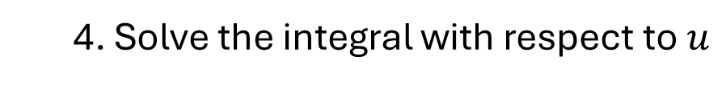
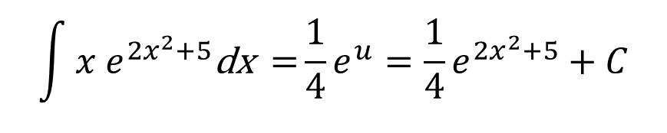

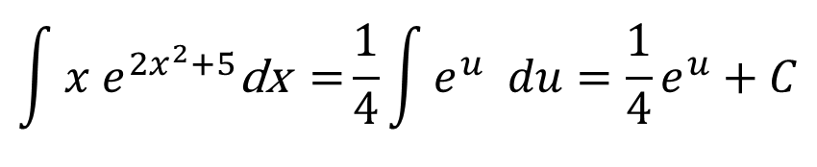
By-the-Numbers Example
$$\int{{x e}^{2x^{2}+5}\text{dx} }$$
  Solve
  4. Solve the integral with respect to $u$
$$\int{{x e}^{2x^{2}+5}\text{dx}\text{ =}\frac{1}{4}\int{e^{u} du}}=\frac{1}{4}e^{u}+C$$
  5. Substitute $g\left(x\right)$ for $u$ in your answer
$$\int{{x e}^{2x^{2}+5}\text{dx}\text{ =}}\frac{1}{4}e^{u}=\frac{1}{4}e^{2x^{2}+5}+C$$

Slide 15

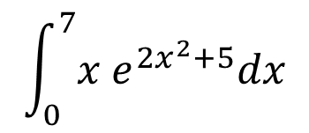

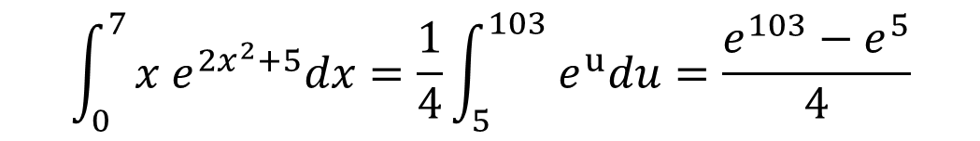

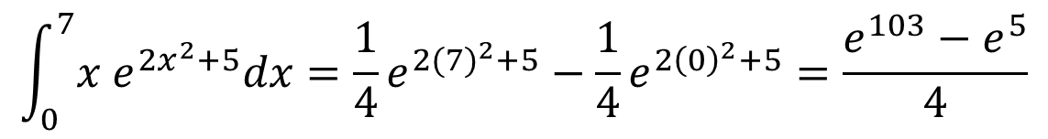
What about Definite Integrals?
$$\int_{0}^{7}{{x e}^{2x^{2}+5}dx}$$
  What happens when we’ve solving for
  instead?
  We have two options:
  1. We can solve the indefinite integral using our to-do list and evaluate our answer at the bounds
$$\int_{0}^{7}{{x e}^{2x^{2}+5}dx}=\frac{1}{4}e^{2{(7)}^{2}+5}−\frac{1}{4}e^{2{\left(0\right)}^{2}+5}=\frac{e^{103}−e^{5}}{4}$$
  2. We can also replace our bounds in Step 3 and evaluate the definite integral in Step 4
  $${u=2x}^{2}+5$$
$$\int_{0}^{7}{{x e}^{2x^{2}+5}dx=\frac{1}{4}\int_{5}^{103}{{ e}^{u}du}}=\frac{e^{103}−e^{5}}{4}$$
  When $x=0, u=5$
  When $x=7, u=103$

